Slide 1

Integration Wave 1

Slide 2
Integration Design Architecture: WAVE 1
Talent Modules
SF Variable Pay
SF Goals Management
Calibration
SF Compensation Management
SF Learning
SF Performance Management
Current HRIS Systems
DataSul HCM
ADP CA
Paylocity
VISMA AGDA
People Profile
SF Succession Management
SF Recruitment Mgt & Marketing
User OData
SF Development Management
XML
SAP SOMNICOR
SAP Cloud Platform
SAP CANDELARIA
HR Core
Add-On 3.0
Add-On 3.0
HR Core
CSV File
CSV File
SFTP
CSV File
FI
Payroll
Payroll
Time Off
CSV File
FI
Benefits
Legacy HR Core
Legacy Payroll
SF Data Process Points
Legacy Reporting & Analytics
WFS Time & Attendance
Key Integration Points
2

Slide 3

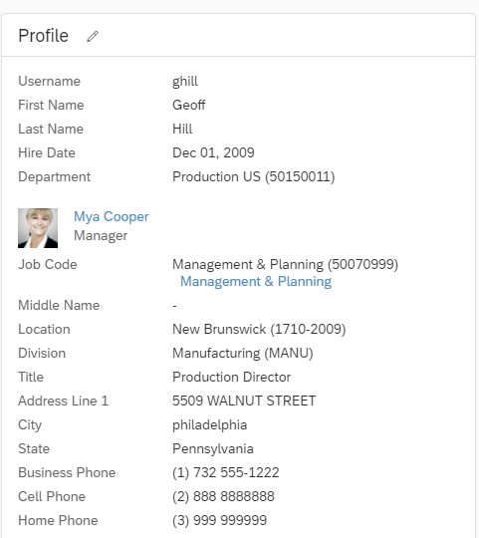
Standard Fields
Fields confirmed from the Employee Central and Recruiting Management data model discussions
•Status –Technical : active or inactive
User ID
Username
Employee ID
First Name
Last Name
Middle Name
Gender
E-mail
Manager
Human Resource
Matrix Manager
Hire Date
Division
Department
Location
Job Code
Title
Time Zone
Business Phone (discussed in EC but not valid in RCM)
Mobile Phone Number (relabel of original Cellphone standard field)
Home Phone Number ( relabel of original Home Phone standard field)
Preferred Name (relabel of original Nickname standard field)
Address Line 1
Address Line 2
City
State/Province (relabel of original State standard field)
ZIP/Postal Code (relabel of original ZIP standard field)
Country
Second Last Name (Custom field 1)
We can add up to 10 custom fields

Slide 4
Standard Fields – Field Mapping
 | User Entity |  |  |  |  |  | Legacy System
People Profile Elements | Field Name | SF Field Label | Field Type | Max Length | Mandatory | Mapping Logic | Field Name | Portlet
Status | status | status | string | 17 | y |  | status
User ID | userId | userId | string | 100 | y |  | userId
Username | username | Username | string | 100 | y |  | username
First Name | firstName | First Name | string | 128 | y |  | firstName
Nickname
Middle Name | mi | Middle Name | string | 128 | n |  | mi
Last Name | lastName | Last Name | string | 128 | y |  | lastName
Suffix
Title | title | Title | string | 255 | n |  | title
Gender | gender | Gender | string | 2 | y |  | gender
Email | email | Email | string | 100 | y |  | email
Manager | manager | Manager | string | 100 | y |  | manager
Human Resource | hr | Human Resource | string | 100 | y |  | hr
Department | department | Department | string | 128 | y |  | department
Job Code | jobCode | Job Code | string | 128 | n |  | jobCode
Division | division | Division | string | 128 | n |  | division
Location | location | Location | string | 128 | n |  | location
Time Zone | timeZone | Time Zone | string | 16 | y |  | timeZone
Hire Date | hireDate | Hire Date | datetime |  | n |  | hireDate
Employee ID | empId | Employee Id | string | 255 | n |  | empId
Business Phone | businessPhone | Business Phone | string | 20 | n |  | businessPhone
Business Fax | fax | Business Fax | string | 20 | n |  | fax
Address Line 1 | addressLine1 | Address 1 | string | 255 | n |  | addressLine1
Address Line 2 | addressLine2 | Address 2 | string | 255 | n |  | addressLine2
City | city | City | string | 255 | n |  | city
State | state | State | string | 20 | n |  | state
ZIP | zipCode | ZIP | string | 10 | n |  | zipCode
Country | country | Country/Region | string | 255 | n |  | country
Review Frequency | reviewFreq | Review Frequency | string | 256 | n |  | reviewFreq
Last Review Date | lastReviewDate | Last Review Date | string |  | n |  | lastReviewDate
Matrix Manager | matrixManager | Matrix Manager | string | 100 | n |  | matrixManager
Default Locale | defaultLocale | Default Locale | string | 32 | n |  | defaultLocale
Proxy | proxy | Proxy | string | 100 | n |  | proxy
Seating Chart
Salutation
Cell Phone
Home Phone

Slide 5
# | Site | Interface/Development | Source System | Target System | Standard or Custom | Interface or Development
1 | Candelaria | Employee Profile Data Feed (CSV) | SAP ERP HCM | SF SFTP (EP) | Custom | Interface
2 | Chapada | Employee Profile Data Feed (CSV) | DataSul HCM | SF SFTP (EP) | Custom | Interface
3 | Corporate | Employee Profile Data Feed (CSV) | ADP CA | SF SFTP (EP) | Custom | Interface
4 | Eagle | Employee Profile Data Feed (CSV) | Paylocity | SF SFTP (EP) | Custom | Interface
5 | Somnicor | Employee Profile Data Feed (CSV) | SAP ERP HCM | SF SFTP (EP) | Custom | Interface
6 | Zinkgruvan | Employee Profile Data Feed (CSV) | VISAM AGDA | SF SFTP (EP) | Custom | Interface

Slide 6
Environment Landscape
DEV
SIT
UAT
PROD
SF BizX
SF BizX
SF BizX
SF BizX
SF Dev
lundinD1
DC17
SF Test
lundinT2
DC17 Preview
SF Test
lundinT3
DC17 Preview
Config Sync
SF Production
lundin
DC17
User OData
User OData
User OData
User OData
Data Flow
Data Flow
Data Flow
Data Flow
SCPI Test Instance
https://lundint1.it-cpi007.cfapps.ca10.hana.ondemand.com/itspaces/shell/discover
SCPI Productive Instance
https://lundinp1.it-cpi007.cfapps.ca10.hana.ondemand.com/itspaces/shell/discover
Interface Sync
Notes:
Appendix

Slide 7



Interface Flow
Source
Employee
Feed File
Middleware
User XML
Import Files
Target
1
3
SF SFTP
Server
SFTP Adapter
SAP
Cloud Platform Integration
User Odata API
SAP
SuccesFactors
SFTP Adapter
User Odata API
Employee Profile
Directory
Filename
Employee Data Interface
Error File
2
User XML
Response
Logs
4

